Slide 1



Neglect Webinar
HJH
11th May 2026
1-2.30pm

Slide 2

What is neglect?
In England, the Children Act 1989 defines neglect as the “persistent failure to meet a child’s basic physical and/or psychological needs,” with emphasis on persistence and serious impairment.
Neglect manifests in many ways, including:
Physical neglect: inadequate provision of food, clothing, hygiene.
Medical neglect: failure to seek or follow medical advice.
Educational neglect: non-attendance or lack of support for learning.
Emotional neglect: absence of affection or emotional responsiveness.
Supervisory neglect: leaving children unsupervised or with inappropriate caregivers.
Environmental neglect: unsafe or unsanitary living conditions.
Neglect often co-occurs with other forms of harm, including physical, sexual and domestic abuse.

Slide 3
Aims for today
To gain a deeper understanding of why Neglect is a priority within Warwickshire
To understand the impact of neglect and cumulative harm
Gain an insight into what action has been taken to address these concerns, including newly developed Multi-Agency Resources and where to find them​
Understand how these tools can be used in multi-agency practice to build a full picture of the child's lived experience
​
Learn where to access further resources and about the upcoming training offer

Slide 4
Today you will...
Hear from Jackie Channell (DSP) on why neglect is a priority in Warwickshire
Meet Bridget Griffen (an Independent Lead Reviewer) who will share learning from Child Safeguarding Practive Review and the impact of cumulative harm.
Hear what children and young people have told us about living with neglect and reflect on what we can learn from this.
Learn more about the Multi-Agency response to the issue of neglect and the new resources that have been produced – including a Neglect Strategy.
​
Experience how these tools can be used in child centered multi-agency practice
Learn where to access the new tools and training and reflect on how they can be used within your agencies

Slide 5
Why Neglect is a priority within Warwickshire
HJH
Jackie Channell
Delegated Safeguarding Partner
Lead Safeguarding Nurse for Coventry and Warwickshire ICB

Slide 6
The National Picture
As of 31 March 2025, neglect was the primary concern for just over half of the 49,400 children in England subject to child protection plans.
Neglect was present in 60% of rapid reviews in 2024-25 (Child Safeguarding Practice Review Panel, Annual Report 2024-2025).
Neglect is the most common form of child maltreatment in England, often co-occurring with other harms.
Child neglect’s widespread prevalence, the potential for long-term harm to children’s physical, emotional and social development and the challenges it presents for effective intervention make it one of the most pressing national safeguarding issues.

Slide 7

The Local Picture - Reviews
Since January 2025, Warwickshire Safeguarding Children Partnership (WSCP) has received 10 Serious Incident Notifications (SIN), with 7 progressing to a Rapid Review.
Of these, 2 of the Rapid Reviews completed have escalated to a full Local Child Safeguarding Practice Review.
To address these concerns, the Neglect Practice Priority Group was established at the end of last year. Its purpose is to strengthen multi-agency understanding of neglect and promote early identification and intervention to safeguard children effectively.
Out of these 10 SINs – 8 featured neglect as a serious concern and area for learning. ​
​
Sadly, 4 of the 8 referred (50%) involved the death of a child or young person.

Slide 8
Neglect as a Key Priority
Guided by our Partnership vision, we have identified Neglect as key priority that will shape our collective efforts to improve our Safeguarding responses and support best outcomes for children and families.
We want all children, young people and families in Warwickshire to be heard, safe, healthy, skilled and happy and access the right support, from the right person, at the right time.
We will listen to the views and understand lived experiences of children/young people and families within the county to inform our understanding of Neglect.
We will work together as a Partnership to ensure that children and young people are protected from harm and neglect, and their welfare is promoted.
We will engage with frontline practitioners to understand the profile and scope of neglect across the county and what the barriers are to identifying and responding to neglect.
We will improve how we evidence the impact of new initiatives and support tools to ensure positive outcomes for children and young people.

Slide 9
Learning from Reviews
HJH
Bridget Griffin
Independent Lead Reviewer
Neglect Thematic Review

Slide 10

The drip, drip, drip of cumulative harm

Slide 11

Where were you when I was six ?
The drip, drip, drip of cumulative harm

Slide 12
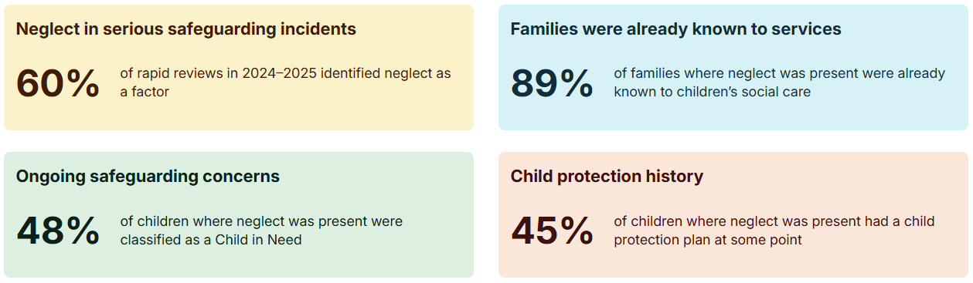
Learning from the National Panel
These figures are drawn from analysis of rapid reviews in 2024-25, including more detailed analysis where neglect was identified.

Slide 13
Learning from the National Panel
Safeguarding reviews show that neglect is common, complex and can be missed. Understanding these recurring issues can help improve practice:
Child neglect can affect babies, children and adolescents but can be missed, especially when concerns relate to poverty, parental challenges, or chronic low‑level issues that build gradually
Delays in identification are frequently linked to unclear definitions, inconsistent thresholds, and reliance on terms such as ‘persistence’ and ‘serious impairment’.
Many responses to neglect are episodic and fragmented, resulting in missed opportunities to understand cumulative harm
Early help and coordinated support are frequently hindered by consent barriers, capacity pressures, and inconsistent multi‑agency working
A more proactive, child‑centred and trauma‑informed approach is needed – one that names neglect clearly and responds early
Strong practice requires shared chronologies, structured tools, multi‑agency information sharing, and a clear focus on the child’s daily life, safety, and wellbeing
Children’s voices and lived experiences are not consistently captured, and home conditions are often not seen or explored in enough depth

Slide 14
What Children and Young People have told us about living with Neglect
HJH
Laura Forrest and Charli Picking
Speaking on behalf of children and young people, informed by direct work with children in care and care leavers​
Voice, Influence and Change Team (WCC)

Slide 15
Who we are and why we are speaking today:
The Voice, Influence & Change Team.
Neglect is a complicated, confusing and a difficult topic for young people to talk about directly.
So, we are here today to share young people's experiences so they do not have to revisit or relive experiences they have worked hard to survive, particularly when they may already carry a sense of blame or responsibility.​
To use our knowledge of working with children in care, care leavers, and young people directly over the last 8 years through our regular work to feed into this session.

Slide 16
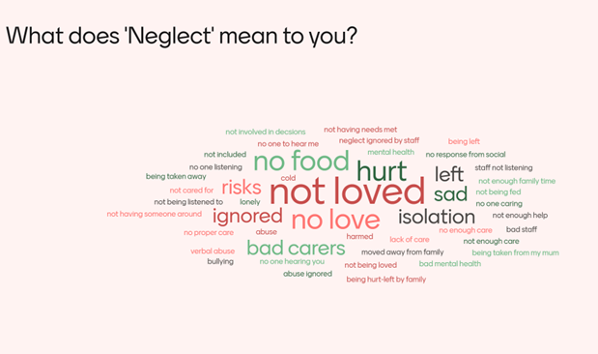
Young people have described what neglect feels like…

Slide 17
I felt sadder when I left home, I wish you had helped my daddy. He loved me but couldn’t do everything I needed.
I was bullied at school, a lot!
My normal isn’t your normal.
I was lonely, mum and dad worked all the time.​
My friend's bedroom was so pretty. Her carpet was really soft. I'd never had carpet in my room.
I didn't say anything, I needed to protect my mum and sister.
No one noticed how different they were to me and my older brother. He got everything.
Why did no one notice? Why did no one help?
​
Mrs B changed my life.
I will remember her forever. Everyone needs a Mrs B!
People kept asking what was wrong and if I was ok. I thought I was. I didn't know what they wanted me to say.
I was hungry. School dinners were yummy, but they hurt my tummy and made me poorly.
I learnt to do adult things too early to look after my family. It wasn't fair.
I didn’t know things could be different, but when they were it felt good after a while.

Slide 18
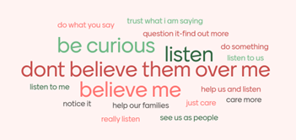
Young people have told us what they want adults to do differently or to know
When someone noticed and helped, things started to change.
It felt scary but I saw things could be different for me.​
Young people want adults who
notice earlier, join the dots, follow through, and do not disappear when things get complicated or when things look well...

Slide 19
Do not stop being curious when you think I am safe or "cared for"...
For all young people:
When neglect ends, it doesn't mean it will never happen again.
For some children, neglect comes back or changes shape rather than disappears.
Sustainable change is what is needed.
Children in care have specifically shared with us:
Neglect can continue within the care journey, even when intentions are good.
Experiences like instability, inconsistency, and lack of communication can feel like neglect.
It is not about blaming carers or professionals, but how the system can be experienced.
Professionals must think about how care feels, not just what care looks like on paper.
Even when systems are working, is it working for us?

Slide 20
Quotes from care experienced young people who have experienced neglect
"I'm more than just my experiences and what happened to me."
"I didn't ask to be neglected, I’m reacting and dealing with this personally, so please allow me the time and don't take it to heart."
"Please be kind, we don't need more on our plate."
"When will my words be enough."

Slide 21
Already
How Processes can feel to Children and Young People
Processes and decisions can feel unclear and confusing and don’t always make sense – help them understand.
Children and young people could be very aware and wary of systems - it must feel safe for them to share.
They notice people not doing what they say and nothing happening, having to repeat things they have already said and people disappearing and support stopping.
Processes should feel like they are making things better for all of us – me and my family.
Words are important; don't make us feel shame or guilt. This is my family and my life – be kind and care about us all (even when that feels hard).

Slide 22
Top Tips
Neglect to children and young people isn't always the 'obvious' or ‘expected’. Be curious.
Children rarely describe neglect using professional definitions. Watch your words.
They talk about being unnoticed, being passed between adults, promises not followed through, and no one checking back. Make the difference.
They may not be aware that they are experiencing neglect as it is ‘normal life’ to them. Help us understand.
​
Neglect is not the same for everyone. One size doesn’t fit all.

Slide 23
Lived experience of neglect and the lifelong impact...
Quote from an adult who experienced childhood neglect.
“What I wanted to share is how important it is that everything discussed today is really taken in. The way professionals notice, respond, and act now can reduce the likelihood that people must carry the impact of neglect into later life, when they are starting their own life and family. Investing in this learning matters, because what happens now and very early, can shape what people face much later on.”
Anyone can spot and report neglect, anyone can support – Be Mrs B!
These new tools will support agencies to help identify and evidence neglect.

Slide 24

Neglect Strategy
Dan Atkins
HJH

Slide 25
‘Why did it take so long to respond?’
The quote above from a Local Child Safeguarding Practice Review reminds us of the urgent question: why, when the signs are so often visible, does it still take so long to respond to neglect?
Challenge yourself, reflect, and ask: Am I confident in identifying the early signs of neglect, especially when they fall below statutory thresholds?
Warwickshire’s Strategic Vision
Partners will commit to work together to support, safeguard and listen to the voices of children, young people and families and to learn from each other to improve outcomes for families across Warwickshire.

Slide 26
Key Priorities
Children and families are heard, safe, healthy, skilled and happy, accessing the right support at the right time.
Strengthen understanding of the lived experience of children and young people.
Improve identification and responses to neglect through shared language, improved tools and practitioner confidence.
​
Enable consistent, evidence‑based multi‑agency practice and measure impact.

Slide 27
Protective Factors
While it is important to identify neglect, it’s equally vital to recognise the signs of safe, nurturing care. Signs of safety and wellbeing can include:
Good health and use of healthcare
Meeting basic physical needs
Regular school attendance and parental engagement
Emotional warmth and secure relationships
Clear boundaries, routines and support with friendships and activities
What Success Looks Like
Success will look different across agencies, but all partners share a commitment to improving the lives of children affected by neglect.

Slide 28
What the Strategy Will Deliver
A new multi‑agency bank of neglect resources to support recognition and response.
Targeted multi‑agency training to improve practitioner knowledge and confidence.
Stronger integration of the child’s voice and lived experience in all activity
.

Slide 29
Our multi-agency response – new tools and resources
HJH
Claire Adkins and Phil Rigotti
Practice and Learning Hub

Slide 30
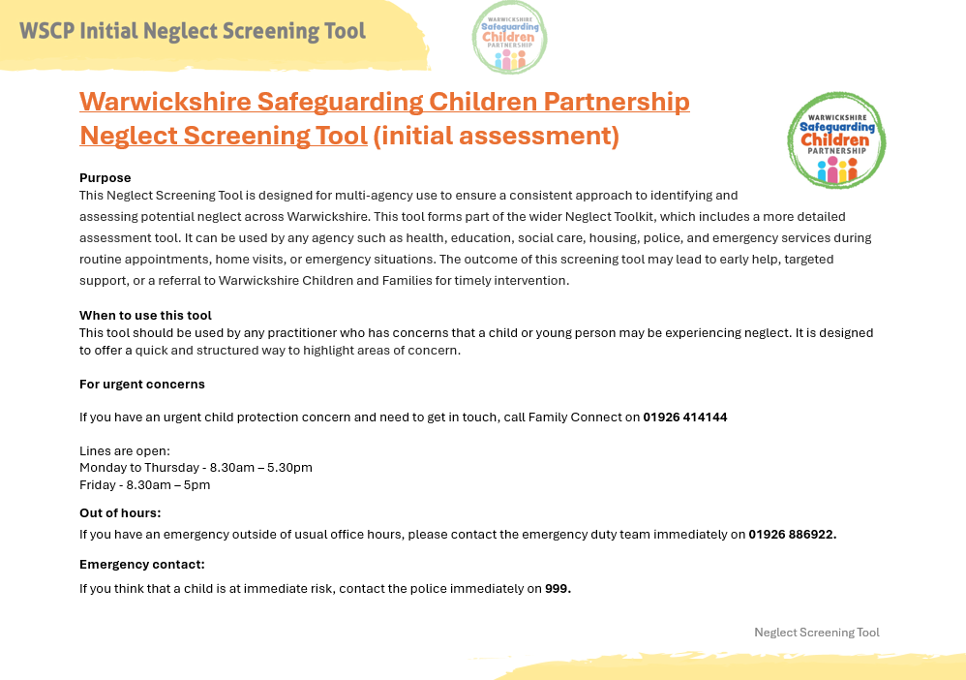

Slide 31
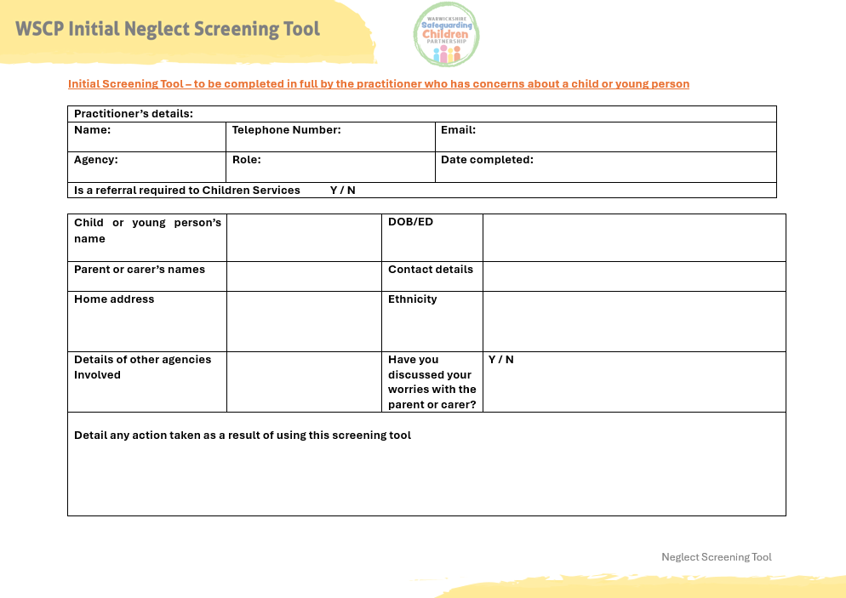

Slide 32
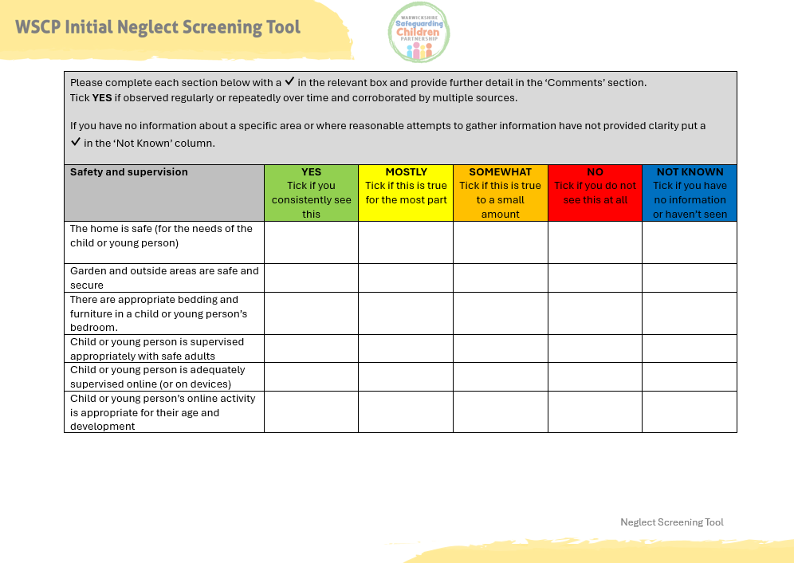
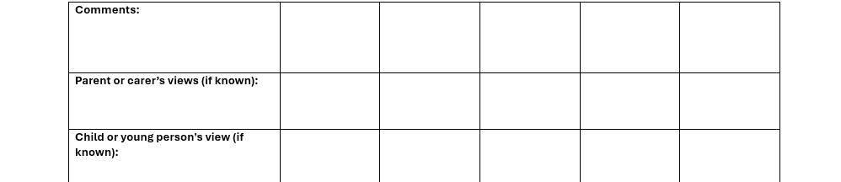

Slide 33
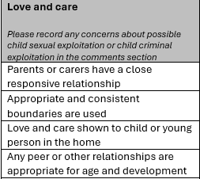
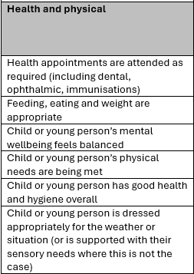
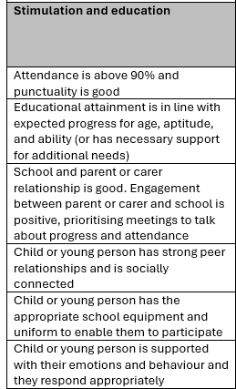
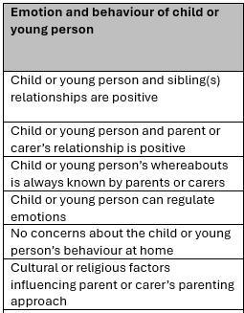
Sections within the Initial Screening Tool

Slide 34
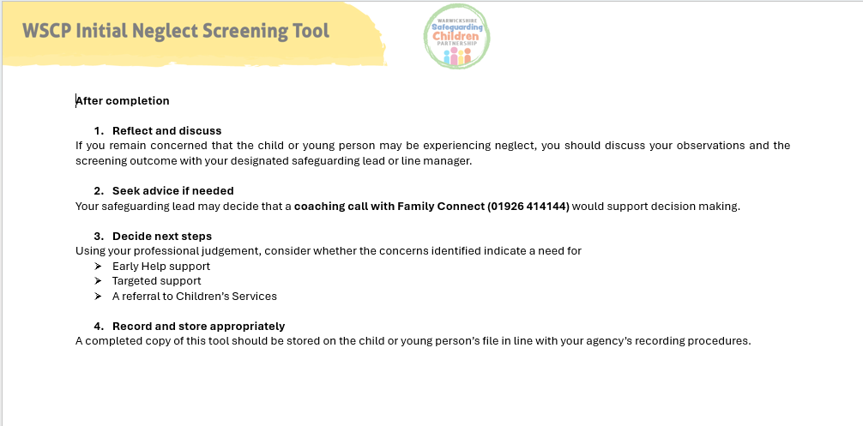

Slide 35
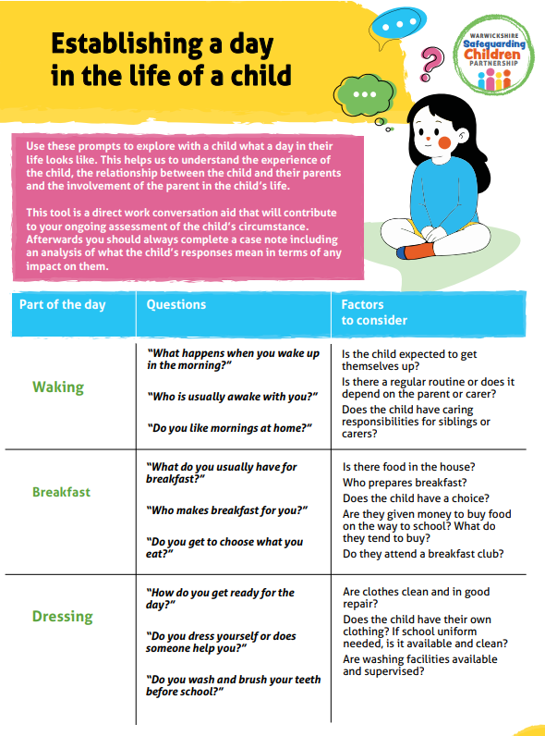

Slide 36
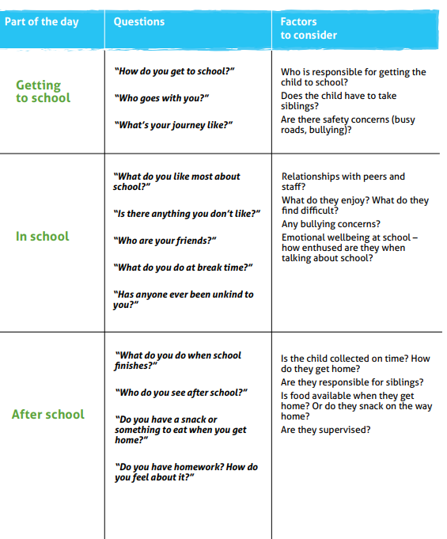
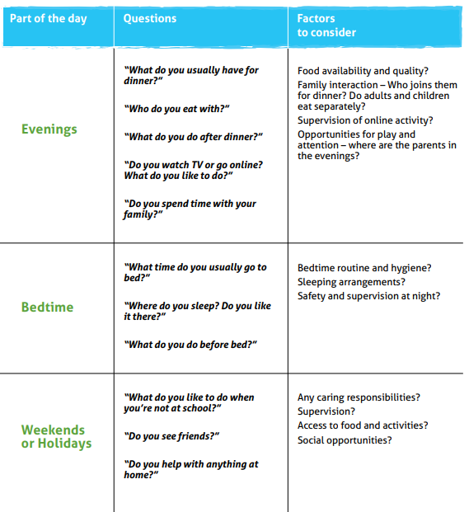

Slide 37
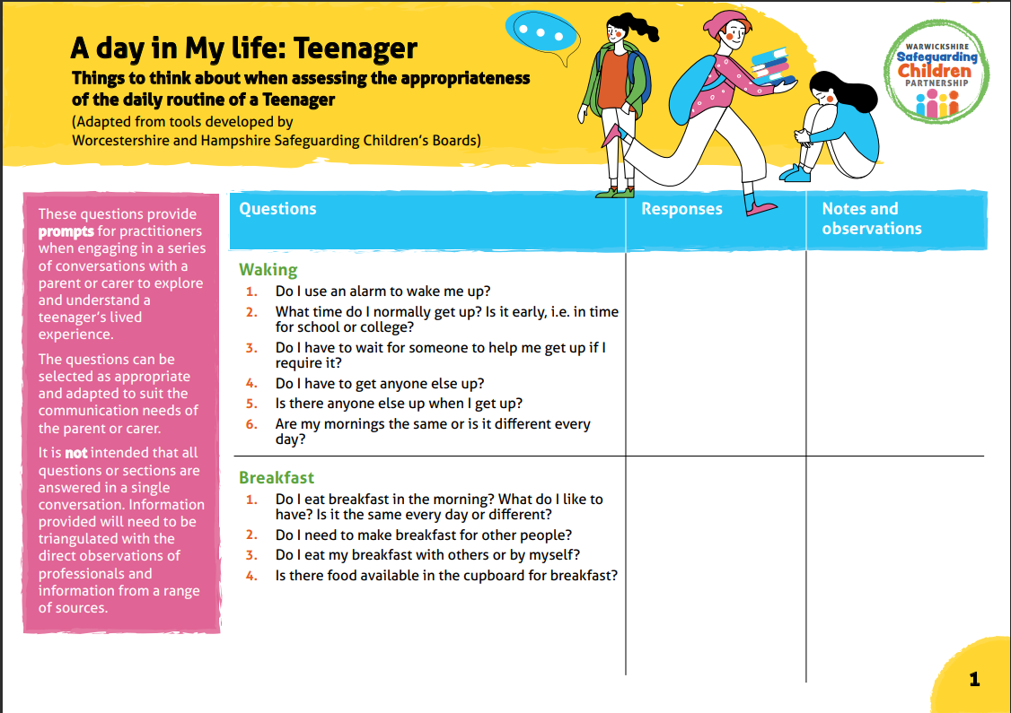

Slide 38
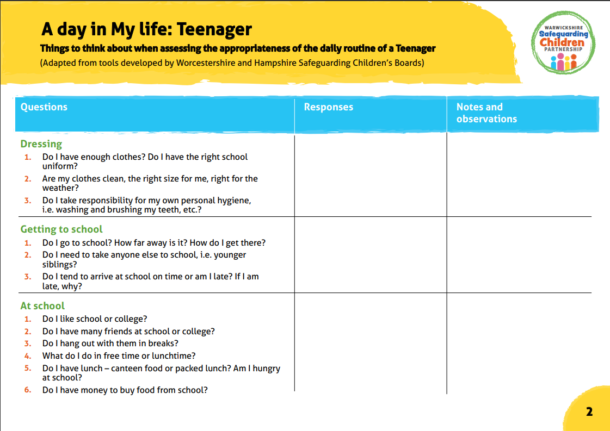

Slide 39
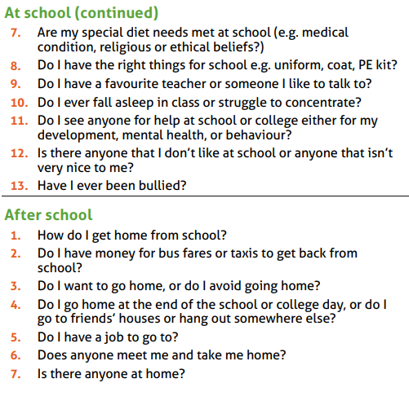
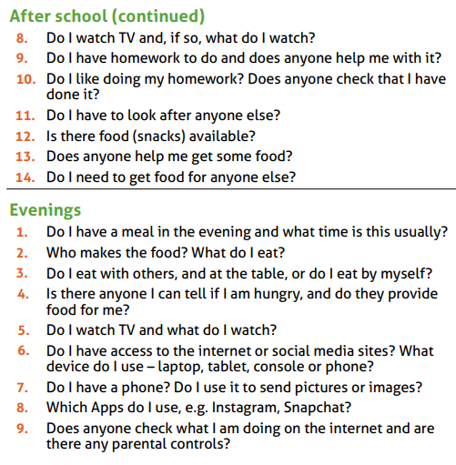
Sections Covered

Slide 40
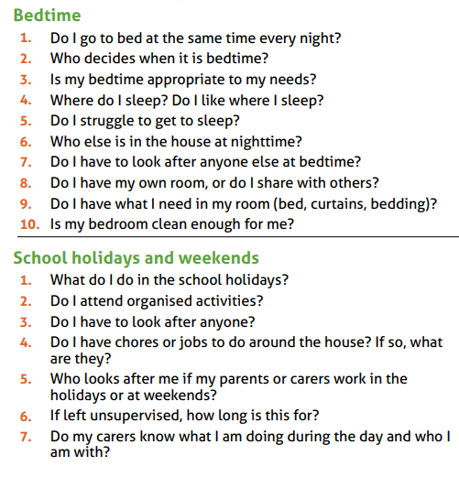
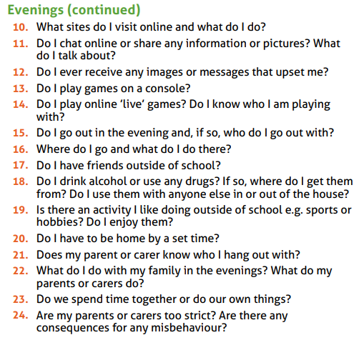
Sections Covered

Slide 41
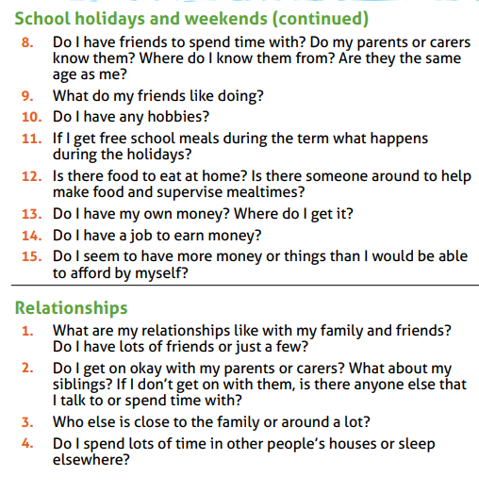
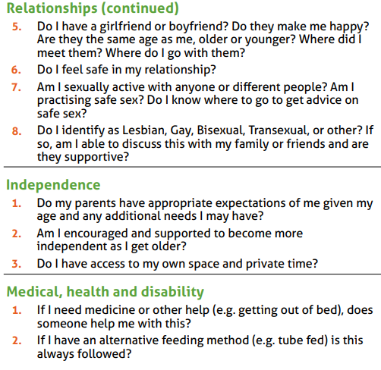
Sections Covered

Slide 42
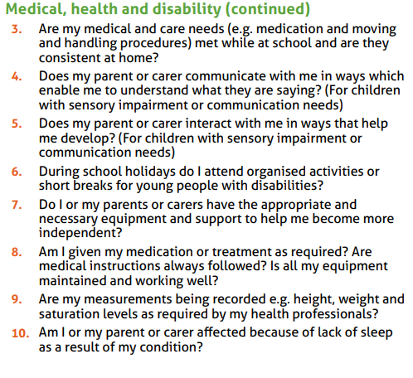
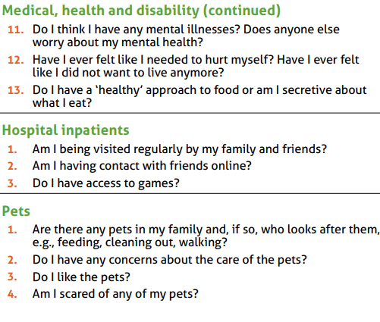
Sections Covered
Notes:
Claire & Phil

Slide 43
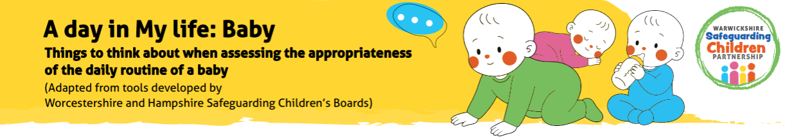

These are available on WSCP website:
https://www.safeguardingwarwickshire.co.uk/safeguarding-children/

Slide 44
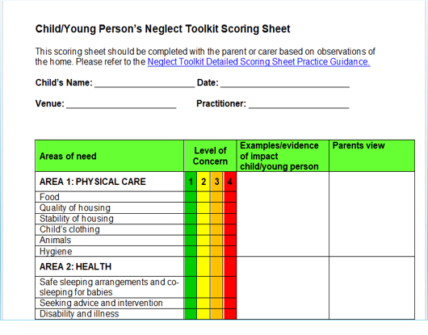
The Neglect Toolkit
The Neglect Toolkit is a Warwickshire Children and Families Document which the initial screening tool will support to complete.
Multi-Agency Partners will not complete this independently but may be contacted by Children’s Social Care for input.
We need to consider how we are assessing neglect. Waiting for a ‘trigger incident’ like a significant injury, or the child being left alone can often be too late.
Use of the Neglect Toolkit at different points throughout agency involvement will help to measure improvement or deterioration.

Slide 45
Neglect Toolkit – Key Points
The Neglect toolkit should be completed for all children that are subject to a CP Plan under the category of neglect by the first RCPC.
There are two parts to the tool, the scoring sheet and the detailed guidance
Provides a base line measure.
Review the chronology at the same time.
If you have concerns of Neglect, regardless of plan type then a Neglect Toolkit should be completed. Consider in emotional abuse cases as well.
RAG Rated
Utilise partner agencies observations based on their area of expertise
Completed WITH the family

Slide 46
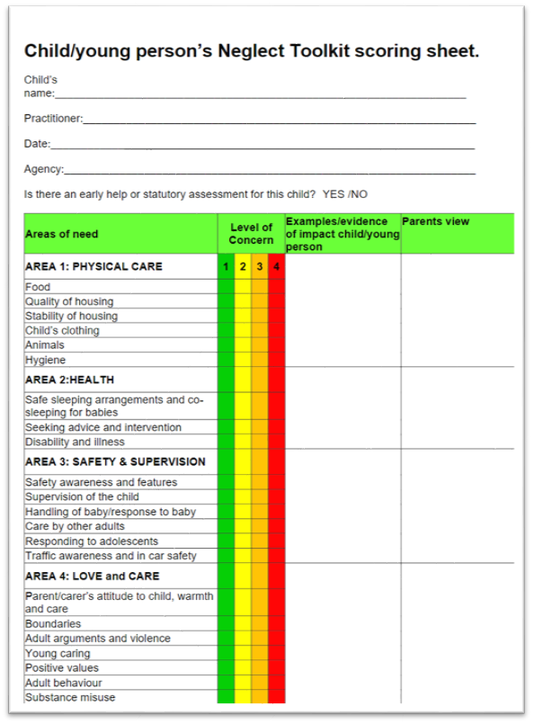
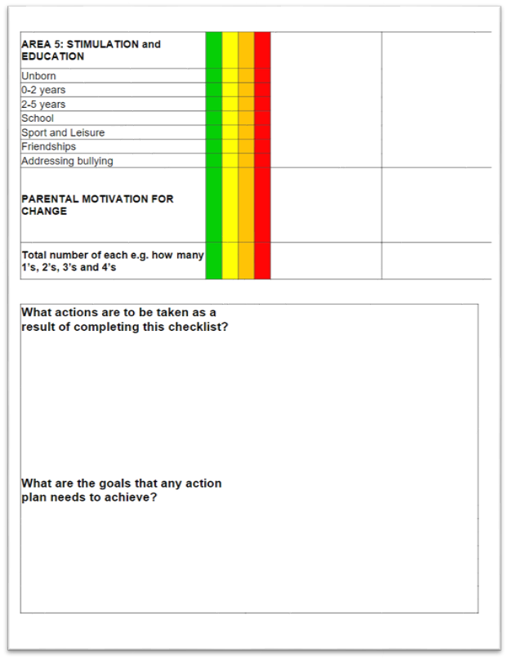
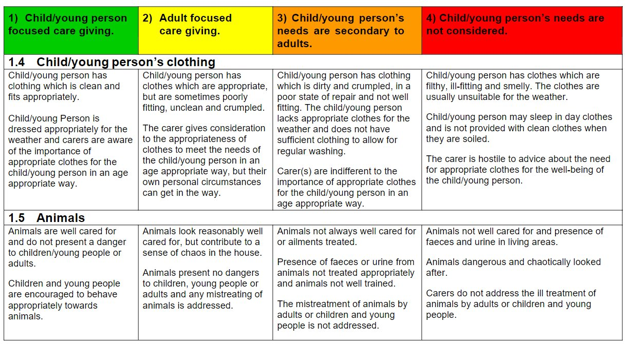
The Neglect Toolkit
The tool assesses five areas, plus an area for considering parental motivation to change.
Each of the areas is split into sub-areas, with accompanying descriptions.
Each area that is relevant is scored 1-5, with 1 being the least amount of concern and 5 being with most.
Examples / Evidence should be included and parents' views of the level of concern recorded.

Slide 47
The Scoring Sheet

Slide 48
Tools in Practice
(Agency Perspectives)
HJH
Multi-Agency Partners

Slide 49
Social Worker starts
neglect toolkit as
part of Family Help Assessment and Plan
Social Worker observes lack of emotional warmth between child
and mother during home visit
Nursery record
significant
amount of
bruising noticed
to shins
Nursery concerned about soiled clothing and full nappies on
arrival in the mornings.
The
Referral
Police ‘lateral check’ records attendance
at the home after
reports of domestic abuse – advice given.
Family Support Worker completes school enrolment forms for mother.
Housing tenancy support
note cluttered housing
during routine visit –
referral made to fire service
for community safety visit.
Fire service carry out a safe and well
check – install smoke alarms and provide advice/ guidance for cluttering.
Health Visitor records
weight below centile and
nappy rash.
Mum struggling
with motivation and mental health.
Paediatrician notes
child not brought despite health visitor referral regarding developmental concerns.
GP record notes ambulance attendance for Faizal.
House reported to be "dirty", and smells of "stale urine“.
Police ‘lateral check’
records concern of child left alone at home, only concerns
noted by attending officer regarding home conditions.

Slide 50

Social Worker starts
neglect toolkit as
part of Family Help Assessment and Plan
Social Worker observes lack of emotional warmth between child and mother during home visit
Nursery record
significant
amount of
bruising noticed
to shins
Nursery concerned about soiled clothing and full nappies on
arrival in the mornings.
Police ‘lateral check’ records attendance
at the home after
reports of domestic abuse – advice given.
Family Support Worker completes school enrolment forms for mother.
Housing tenancy support
note cluttered housing
during routine visit –
referral made to fire service
for community safety visit.
Fire service carry
out a sfe and well
check – install smoke alarms and provide advice/ guidance for cluttering.
Health Visitor records
weight below centile and
nappy rash.
Mum struggling
with motivation and mental health.
Paediatrician notes
child not brought despite health visitor referral regarding developmental concerns.
GP record notes ambulance attendance for Faizal.
House reported to be "dirty", and smells of "stale urine“.
Police ‘lateral check’
records concern of child left alone at home, home
condition concerns
noted by attending officer.

Slide 51
What Next?
HJH
Dan Atkins

Slide 52
What to take away from today
Act early and stay curious
Notice small, repeated concerns — neglect is usually cumulative, not a single event.
Name neglect clearly
Avoid vague language; being explicit helps trigger timely action and shared understanding.
See the child’s lived experience
Focus on what daily life feels like for the child, not just parental explanations or isolated incidents.
Work collaboratively
Share information, use neglect tools consistently, and build a holistic, multi‑agency picture of risk and need.
Reflect on current practice
Reflect on the children and families you currently work with. Consider both the immediate and longer-term impact of neglect, and identify how you can support and sustain meaningful, lasting change.

Slide 53
Further Information
We have a dedicated NEGLECT webpage on the WSCP website where you can access:
WSCP Neglect Initial Screening Tool
Day in the Life of a Child direct work resources
Links to further resources e.g from the National Panel
Coming Soon
Training videos
WSCP Neglect Strategy

Slide 54
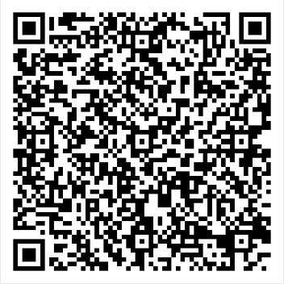
Evaluation Form
Please share your views on today’s session by completing the evaluation form.
Thank you for attending.

