Slide 1

Adolescent Strategy Webinar
HJH
14th July 2026
10-11am

Slide 2

Aims for today
Understand the rationale for change and why the new strategy has been produced
Understand the key risks adolescents face and what can be done to protect them
Understand how adolescents in Warwickshire feel about safety
Reflect on how the strategy can be used within your agency
Learn where to access further resources to support adolescents

Slide 3
Why Adolescent Safety remains a priority within Warwickshire
HJH

Slide 4
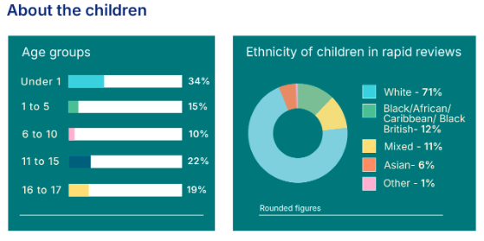
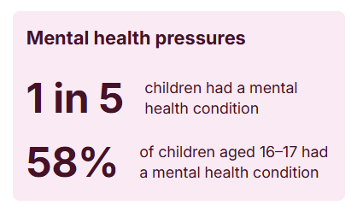
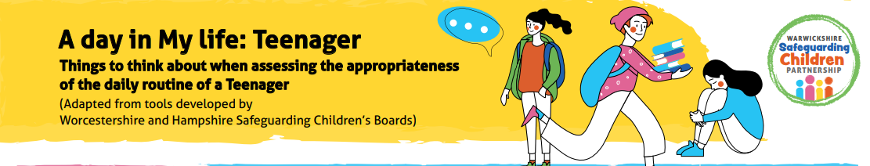
National Picture 2024/25
HJH
60% of reviews in 2024-5 featured NEGLECT.
WSCP have developed a bank of resources to support with this, including a ‘Day in the Life of Teenager’ document which helps to understand lived experiences.
They can be found here.
16% of deaths were caused by suicide.
72% of reviews identified a lack of co-ordination or handover between services.
41% of children subject to a Child Safeguarding Practice Review were aged between 11-17.
(274 reviews – 360 children affected)

Slide 5
Rationale for change
Warwickshire Safeguarding Children Partnership made a commitment to: 'Develop a joint approach to ensure children are safe within the community from risk of harm outside their home and are visible to services’.
Warwickshire had an Exploitation Strategy and we were keen, as a multi-agency partnership, to replace this with an adolescent strategy covering wider aspects of safeguarding risks to young people in Warwickshire.
As a result of this, members of the adolescent safeguarding sub-group agreed that the strategy should be rewritten rather than simply updated.
A Task and Finish Group was formed with representatives from health, education, police, and social care. Collectively, they agreed the content for the strategy and used their expertise to write relevant sections.
It was also agreed that the voice of adolescents should form a crucial part of this work to ensure we got it right for young people.
The strategy has been developed in line with Working Together to Safeguard Children 2026 and reflects the national shift towards Family Help, contextual safeguarding and stronger multi-agency collaboration.

Slide 6
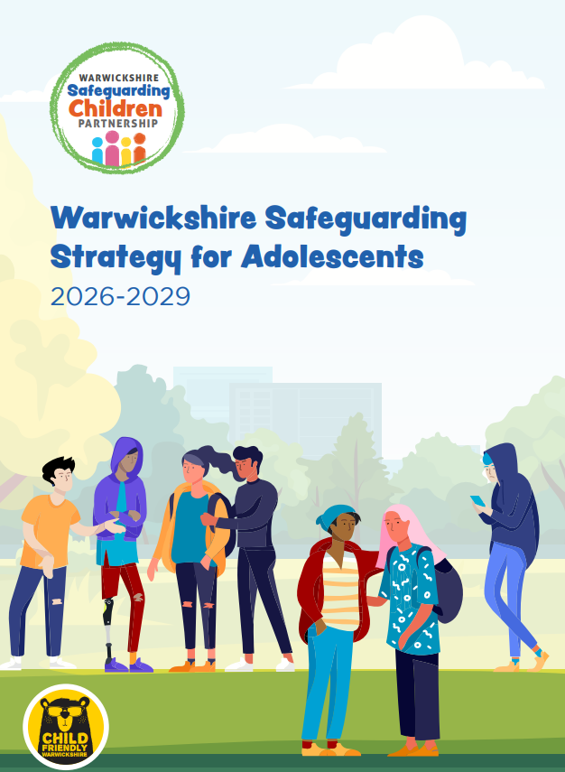
Adolescent Strategy
Becky Sumner and Nigel Jones
HJH

Slide 7
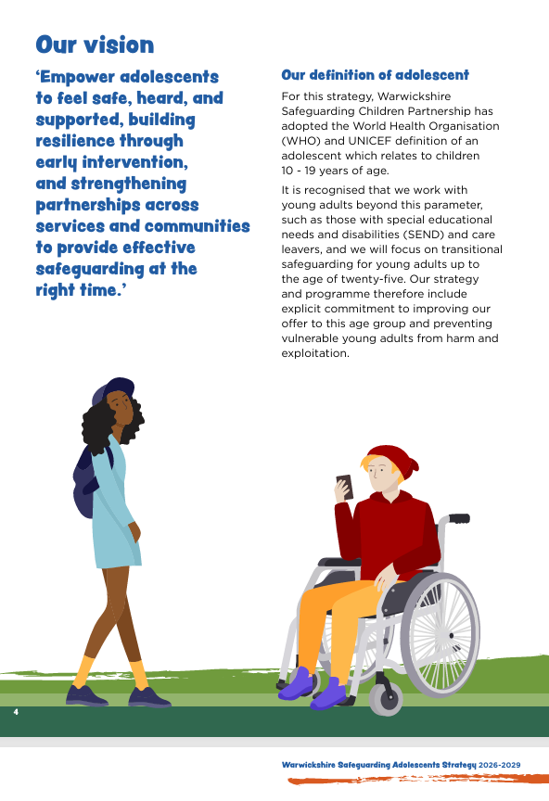
Our Core Principles
Our principles guide our actions and decisions across the Safeguarding Children Partnership and workforce to protect young people from extra familial harm. These are aligned to the Spectrum of Support, guiding responses to emerging concerns. By working together, we aim to create flexible services that respond to the needs of children and families, delivering the right level of support at the right time. This approach shifts the focus from managing short-term crisis to providing effective, early support for children, young people, and their families.
Understand adolescence
Work collaboratively to ensure the best outcomes for adolescents
See adolescents as children first
Respect the voice, experience and expertise of children and young people
Focus on strengths, utilising a trauma informed and relational approach
Value diversity and challenge inequalities, discrimination and disproportionality

Slide 8
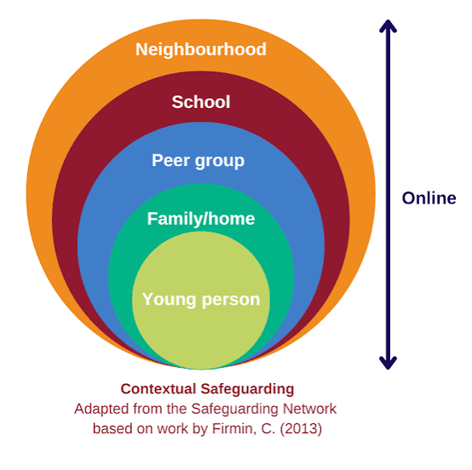
Prevalence of Extra-Familial Harm
During adolescence the nature of the risks faced by young people, and the way that they experience these risks, often differs from earlier childhood – as do their needs. Specifically, young people may be faced with a new set of complex risks – ones not posed by families, but instead by peers, partners and adults unconnected to their families.
Child Criminal and Sexual Exploitation
Young People Missing from Home, Education and Care
Online Harm and Abuse
Modern Slavery and Trafficking
Serious Youth Violence
Young People who Offend
Peer on Peer Abuse
Radicalisation and Extremism
Focuses on harm outside the home. It recognises that as young people spend more time away from home, the risks they face change. ​

Slide 9
Risk Factors
We have identified a number of key risk factors within the strategy:
Educational Neglect
Healthcare Neglect
Poor mental health and wellbeing
Substance misuse and vaping
Separated children (Unaccompanied Asylum-Seeking Children UASC)
Homelessness
Children in Care and Care Leavers
Special Educational Needs and Disability (SEND)
Socioeconomic deprivation
Resources to support identifying Neglect can be found here.

Slide 10
Key Priorities
1. Embed a contextual safeguarding approach across the partnership.
Contextual safeguarding is central to our safeguarding approach. We will address the settings in which extra-familial harm occurs, with the objective of fostering safer spaces for children and young people across our county.
2. Prioritising prevention and early intervention
We will strengthen the resilience of children and young people by ensuring timely access to appropriate support and early help. This preventative approach aims to address emerging vulnerabilities at the earliest opportunity, reducing the risk of escalation into extra-familial harm and enabling children and young people to achieve positive outcomes and thrive.
.
3. Provide effective protection and deliver the right level of support at the right time.
We will develop and deliver targeted, evidence-informed support services for children and young people affected by extra-familial harm. These interventions will be designed to reduce exposure to ongoing risk, support their recovery, and enable them to rebuild their lives with stability and resilience.
.
4. Enhance the multi-agency approach to identification and disruption of those who pose a risk to children and young people.
We will continue to establish a robust multi-agency approach which utilises local intelligence to proactively identify individuals and groups who pose a risk to children and young people, and to coordinate effective disruption of harmful activity.
​

Slide 11
Delivering on Our Priorities
HJH
A Multi-Agency Approach

Slide 12
1. Embedding a contextual safeguarding approach
Warwickshire is embedding a contextual safeguarding approach to better protect young people from harm occurring outside the home by strengthening multi‑agency assessments, responses and data sharing. ​
New holistic assessment processes, Locality Contextual Safeguarding Meetings (LCSMs) and an operational oversight group help identify and reduce risks in peer groups and community settings, supported by a countywide network of Champions and updated threshold guidance. ​
Ongoing priorities include improving how contextual risks are recorded, strengthening community partnerships and ensuring young people’s voices shape safer places and spaces.
To achieve this we will:
Review our current approach, broaden engagement with local services and community organisations, and improve how we record and use information about extra familial contexts. ​
Strengthen context‑based assessments, work more closely with peer groups, support safe community spaces, and embed contextual safeguarding principles into the planning and design of public environments.

Slide 13
2. Prioritising Prevention and Early Intervention
Support should not depend on harm escalating, and we aim to build resilience so children and young people can thrive within their families and communities.
Early help will be offered as soon as possible to prevent vulnerabilities from developing into harm, and clear communication with young people and families will ensure they can access information, advice and support when they need it.
​
A preventative approach requires all sectors to recognise signs and early indicators of risk, identify when young people are placed in harmful situations, and share information effectively.
To achieve this we will:
Strengthen young people’s resilience through school‑based education, expand outreach youth work, and work with community and faith partners on early prevention.
Improve access to clear information, deliver a coordinated multi‑agency response to harm outside the home, and grow our Contextual Safeguarding Champions network.
Further embed locality‑based Family Help Hubs, enhance data sharing to support safer communities, promote inclusive school practices, broaden positive youth opportunities, and expand targeted substance misuse support.

Slide 14
3. Provide Effective Protection and Deliver the Right Support at the Right Time
Young people affected by extra‑familial harm need targeted, timely intervention to reduce risk and prevent long term negative impacts on their wellbeing, development, and future opportunities.
Practitioners need to continue to develop their knowledge and skills and be aware of new and emerging threats and keep up to date with learning from local and national reviews and national research, as well as expertise from the lived experience of young people and families.
​
Seek to proactively address concepts of ‘unconscious bias’ and ‘adultification’ and our approach to protection and support will include a focus on ‘reachable moments’ caused by significant changes in circumstances that can escalate risk rapidly, such as exclusion from school, to ensure the right support is provided when it is needed.
To achieve this we will:
Align our commissioned services to effectively support adolescents affected by harm outside the home, equip practitioners with the knowledge and skills required, and promote a child first and trauma sensitive approach across the partnership.
Develop improved pathways for young people transitioning to adulthood to access relevant support, safeguarding and protection from harm, ensuring they continue to receive the right support to stay safe and thrive.

Slide 15
4. Enhance the multi-agency approach to identification and disruption of those who pose a risk to children and young people
The partnership aims to strengthen a proactive multi agency approach that uses local intelligence to identify individuals and locations posing risks to children and young people, taking decisive action to disrupt harmful activity.
​
Understanding the nature and patterns of extra familial harm is essential to effectively target, prevent, and challenge offending behaviour. Contextual Safeguarding Meetings (CSMs) and Locality Contextual Safeguarding Meetings (LCSMs) bring together key partners to share intelligence, develop disruption plans, and manage concerns linked to specific people and places.
We seek to build and maintain strong relationships with local services, businesses, and community organisations giving us a fuller picture of risks affecting young people.
We will act against people and unsafe locations causing concern, prioritising disruption by using both criminal and civil powers such as those related to licensing, health and safety, fraud, and housing to intervene against perpetrators and unsafe locations.
To achieve this we will:
Enhance cross border information sharing to develop a comprehensive local profile of extra-familial harm, make use of the full range of disruption tools and tactics, and empower communities to speak up about violence and crime, ensuring perpetrators are identified quickly and appropriate enforcement action is taken.

Slide 16
Summary of our Multi Agency Offer
We offer a range of services across the Spectrum of Support through our partnership to meet the varying needs of children and young people, including a diverse and well established voluntary and community sector provision.
SPECIALIST SERVICES covering a range of multi-agency and community services supporting children and young people across safeguarding, care, education, justice, and targeted intervention.
FAMILY HELP including disability, mental health, early help, SEND, youth, policing, and voluntary sector services supporting children and families.
EARLY SUPPORT including early help, policing, health, youth, school, and voluntary services supporting young people.
UNIVERSAL SERVICES including education, universal youth and leisure services, health professionals, safe community spaces, and voluntary sector support.

Slide 17

How we will know the strategy is having impact
Better identification of adolescents at risk
Improved multi-agency responses
Earlier intervention and support
Improved outcomes for young people
Develop a robust performance management framework to track progress and ensure continuous improvement
Learning from data, audits and young people's feedback

Slide 18
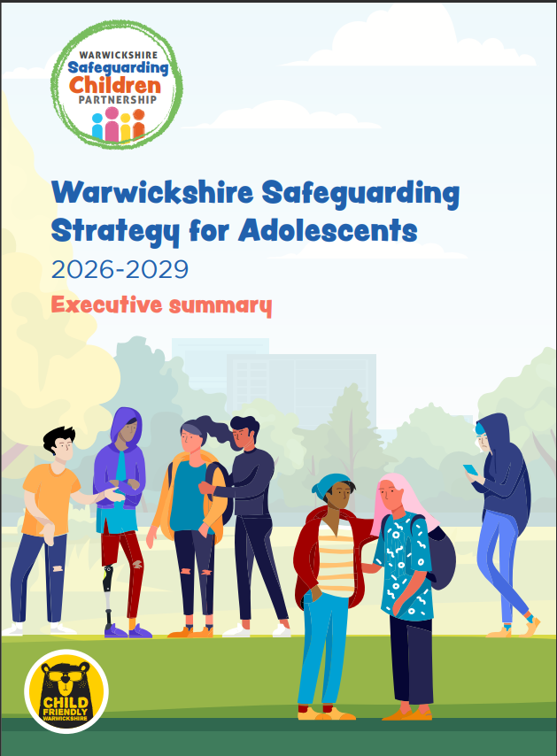
EXECUTIVE SUMMARY
An Executive Summary suitable for raising awareness with members of your leadership team is available on the WSCP website.

Slide 19
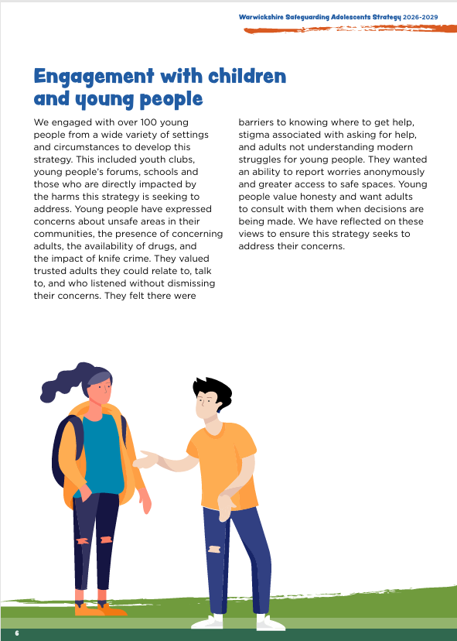
Learning from Adolescents -
What Young People told us
HJH
Laura Forrest and James Worrall​
Speaking on behalf of children and young people​​
Voice, Influence and Change Team (WCC)​

Slide 20
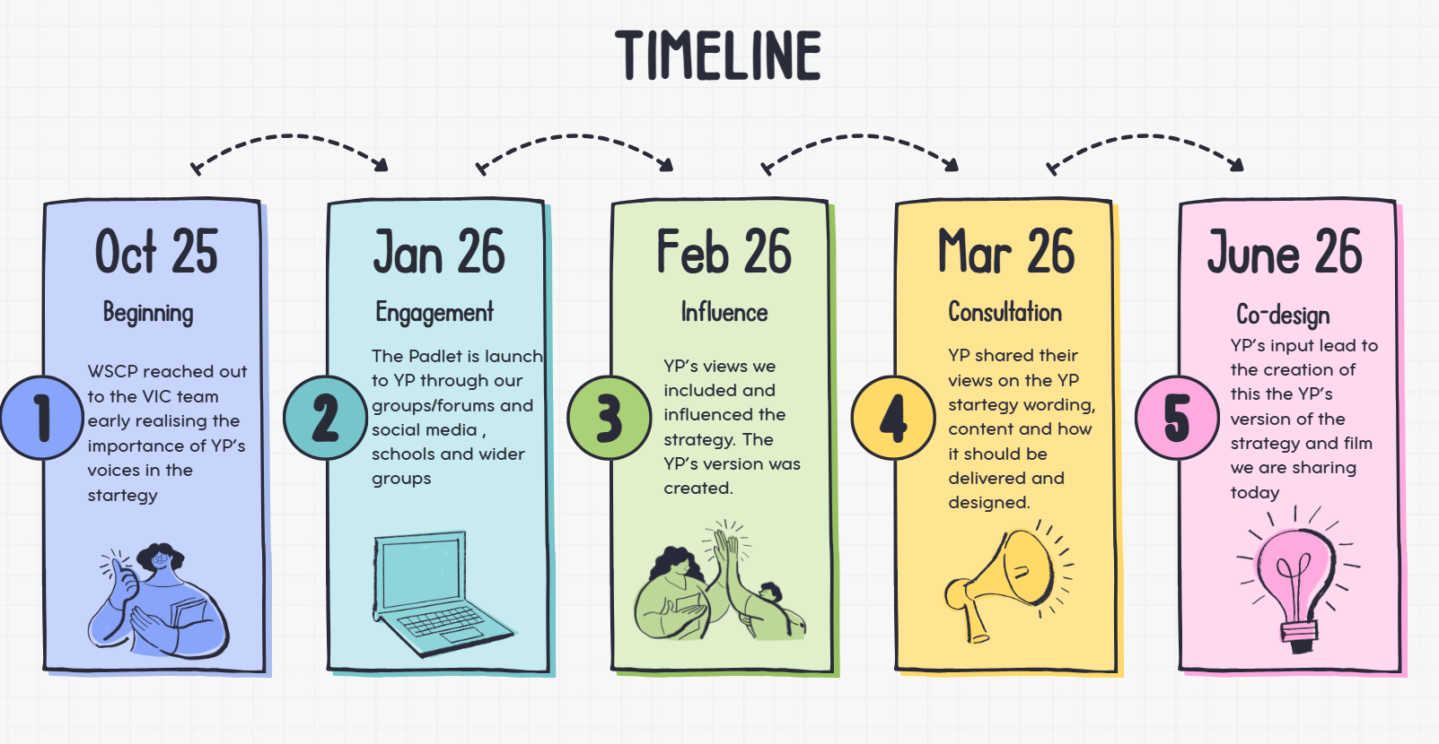



Slide 21
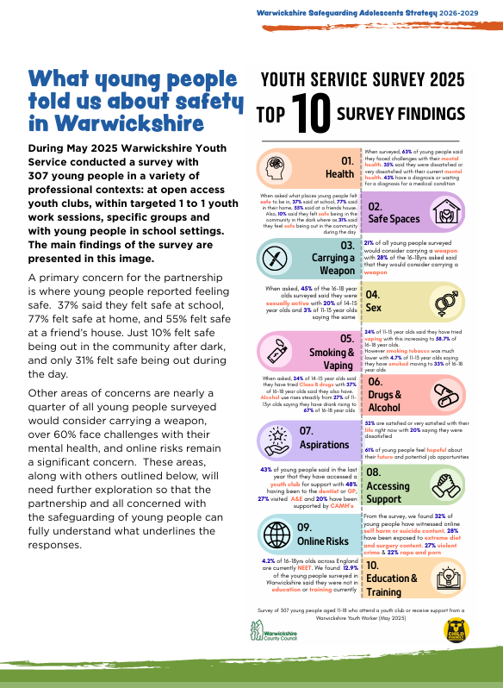
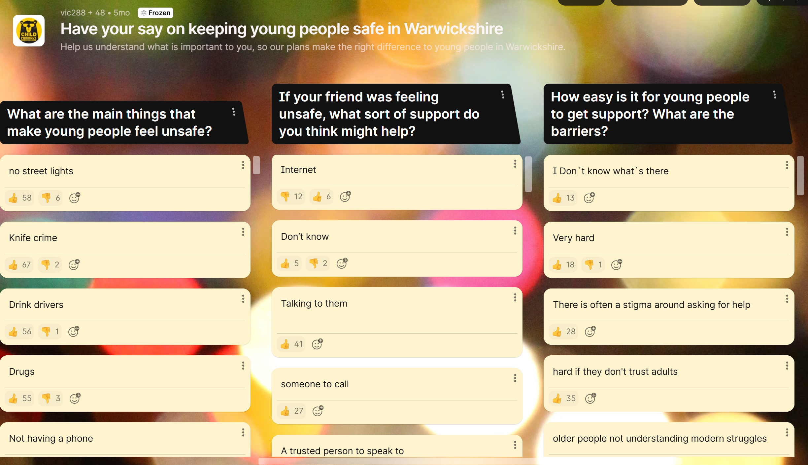


Slide 22
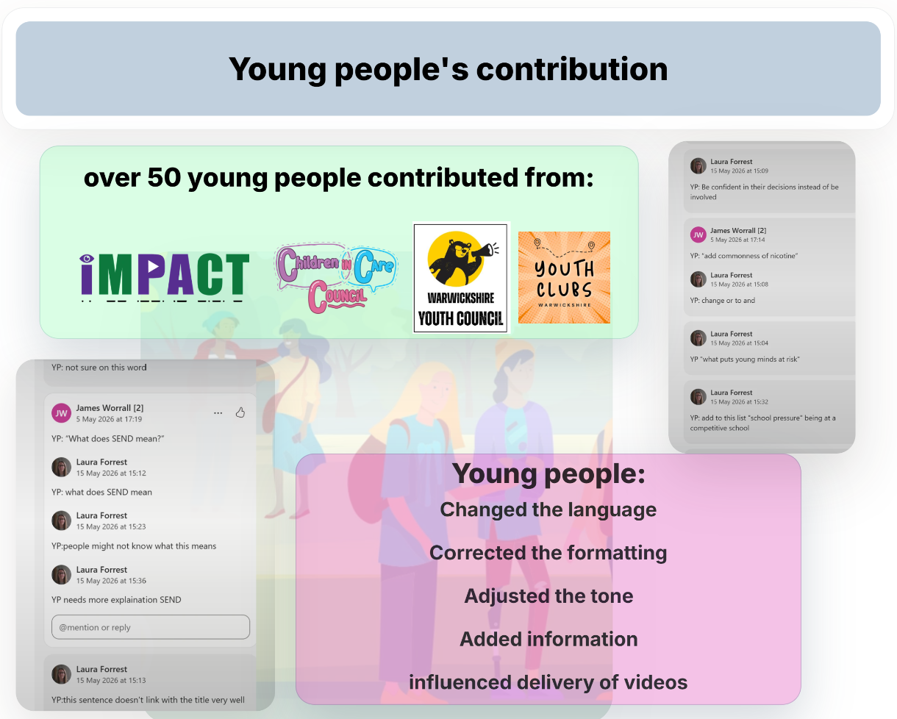

es

Slide 23
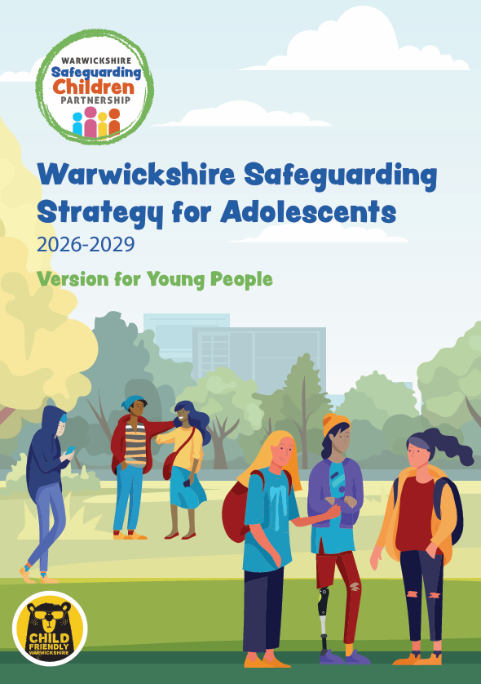
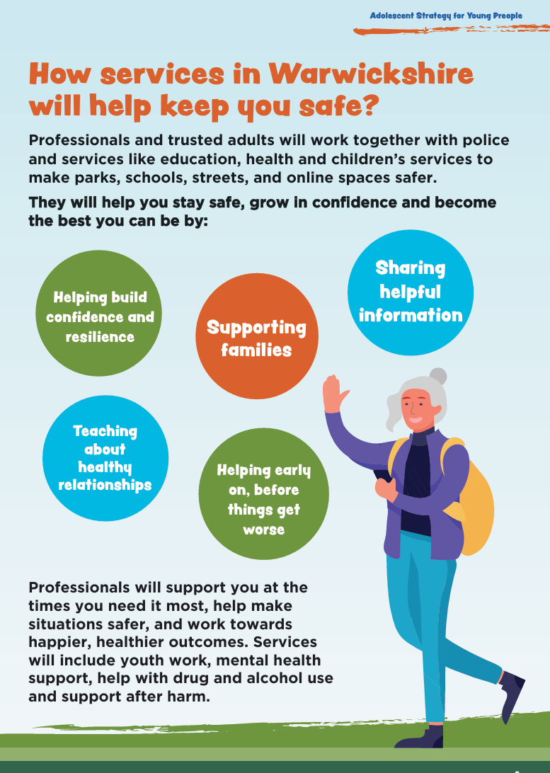
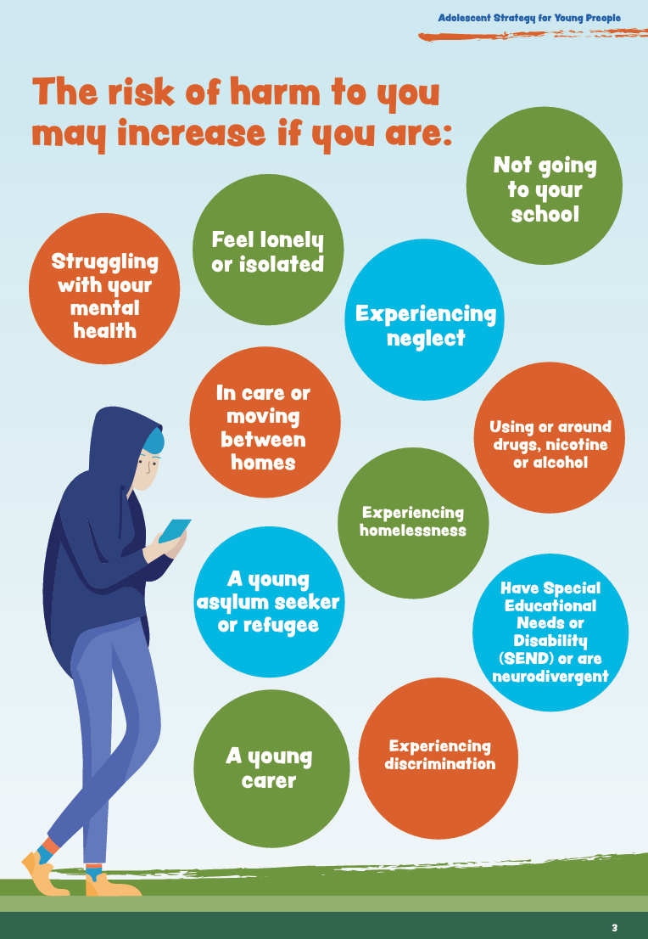
"I think the strategy is good and easy for young people to understand. I like that it covers important areas such as exploitation, online harm, violence and radicalisation, and that it focuses on supporting young people rather than blaming them"
Youth Council member

Slide 24


Slide 25
Useful Information for Practitioners
HJH

Slide 26
Safeguarding Advice for the Summer Holidays
For professionals, the summer holidays present unique safeguarding challenges for young people due to the loss of structured school support. Core safeguarding risks include:
Exploitation & Criminal Activity
Water Safety
Substance and Alcohol Misuse
Online Harms and Grooming
Mental Health and Neglect

Slide 27
Recommended Professional Actions
Before term ends, professionals should actively identify vulnerable students and implement targeted interventions:
Safety Workshops
Deliver PSHE-style safety interventions covering open water risks, rail track trespass, drug/alcohol awareness, and consent.
Multi-Agency Collaboration
Share critical intelligence with local social workers, youth services, and community police to map out local hot-spots for anti-social behaviour or trespassing.
Direct Communication
Provide clear signposting for young people. Resources like Talk to Frank for substance advice and The Mix for general youth support are excellent direct-to-youth tools.
Holiday Provision
Encourage families and young people to access local, supervised holiday clubs and programs (often co-ordinated via local councils to ensure safeguarding protocols are met)

Slide 28
What Next?
HJH

Slide 29
6 things to do after today
Read and share the strategy within your agency. Consider signing up to become a Contextual Safeguarding Champion.
Visit the websites linked for more practical tips to safeguard adolescents. Share these with your teams.
Reflect on how your service supports adolescents experiencing extra-familial harm.
Use the neglect resources to further support adolescents and their lived experiences.
Identify one change your agency can make over the next 12 months.
Share the Version for Young People and the animation with young people.

Slide 30
Further Information
The full Adolescent Strategy, Executive Summary and Version for Young People can be found here on WSCP website.
The video for young people can be found here.
A range of resources linked to Early Identification of Neglect can be found here.
The National Panel has some excellent information and resources linked to Safeguarding Children not in School which can be found here.
A range of 7 Minute Briefings covering a wide range of topics linked to safeguarding adolescents can be found here.
WSCP Escalation Policy and supporting documents can be found here.

Slide 31

Evaluation Form
Please share your views on today’s session by completing the evaluation form.
Thank you for attending.

